Slide 1
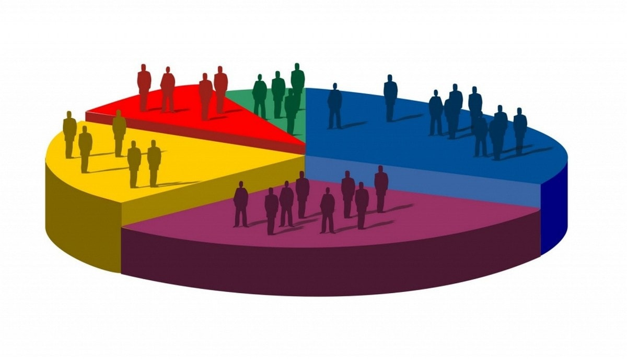
Market Segmentation
Marcio Sugar
Maryam Nouri

Slide 2

Market Segmentation
Market segmentation is the practice of dividing consumers into groups based on shared needs, desires, and preferences.
Key benefits:
Determine market opportunities
Tailor-make marketing initiatives
Product development and design
Determine product pricing

Slide 3
What Companies Use Segmentation?
Numerous types of businesses use market segmentation to optimize their ability to sell to a wide variety of consumers, including:
Skincare, haircare, and beauty product manufacturers
Car companies
Clothing and apparel suppliers
Banks and other financial institutions
Television networks and media outlets
Retailers, …

Slide 4
Data
Source: Kaggle dataset
A food retailer company data set with following features:
People | Products | Promotion | Place
ID | MntWines | NumDealsPurchases | NumWebPurchases
Year_Birth | MntFruits | AcceptedCmp1 | NumCatalogPurchases
Education | MntMeatProducts | AcceptedCmp2 | NumStorePurchases
Marital_Status | MntFishProducts | AcceptedCmp3 | NumWebVisitsMonth
Income | MntSweetProducts | AcceptedCmp4
Kidhome | MntGoldProds | AcceptedCmp5
Teenhome |  | Response
Dt_Customer
Recency
Complain

Slide 5




Solution Requirements
Easy implementation
Scalability
Cost efficient
High levels of security

Slide 6
Cloud vs on-perm solution based on Requirements
Feature | Cloud Solution | On-Premise Software | Results
Software ownership | Vendor | Business | On-Premise
Accessibility | Easy | Hard | Cloud
Deployment | Fast | Time consuming | Cloud
Cost | High over time | Predictable and low | On-Premise
Security | High | Low | Cloud
Scalability | High | Low | Cloud
Notes:
There is no Pricing Calculator for Vertex AI, only this page: https://cloud.google.com/vertex-ai/pricing#user-managed-notebooks

Slide 7
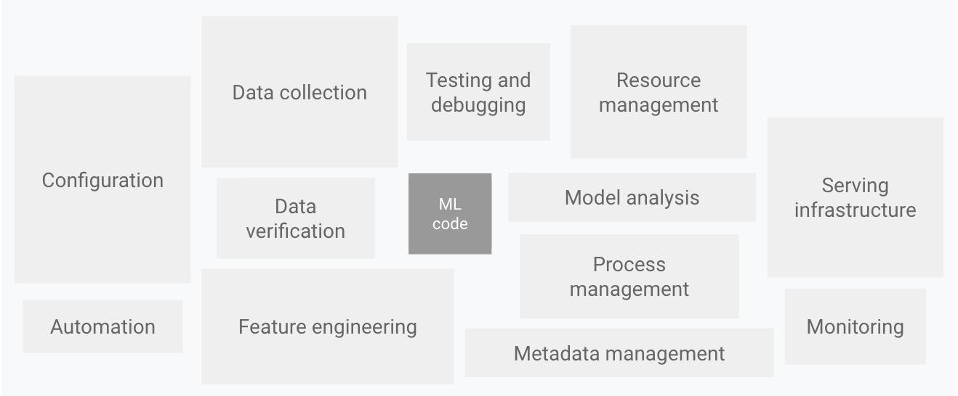
MLOps
A discipline focused on the deployment, testing, monitoring, and automation of ML systems in production.
source

Slide 8
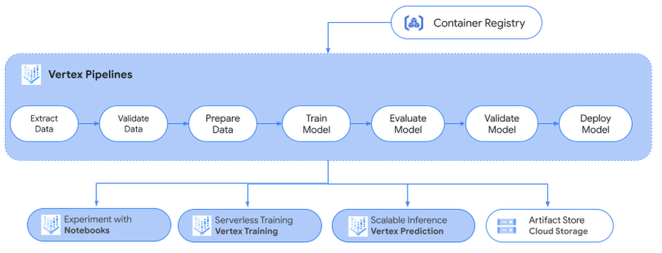
ML Workflow on Vertex AI
source

Slide 9
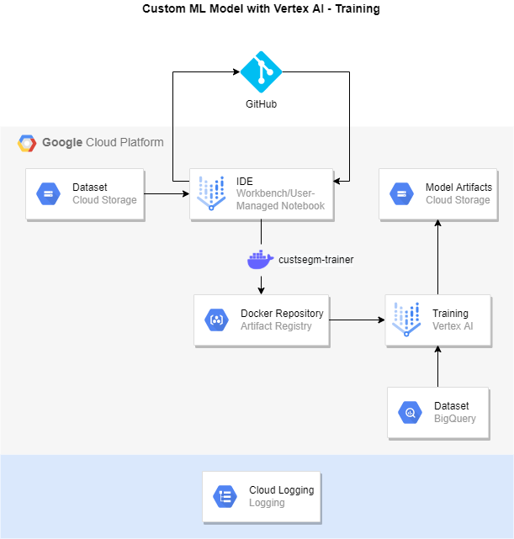
MLOps
Architecture
Vertex AI 1/2 - Training In:
Training Dataset
Out:
Model
Evaluation (not implemented)

Slide 10
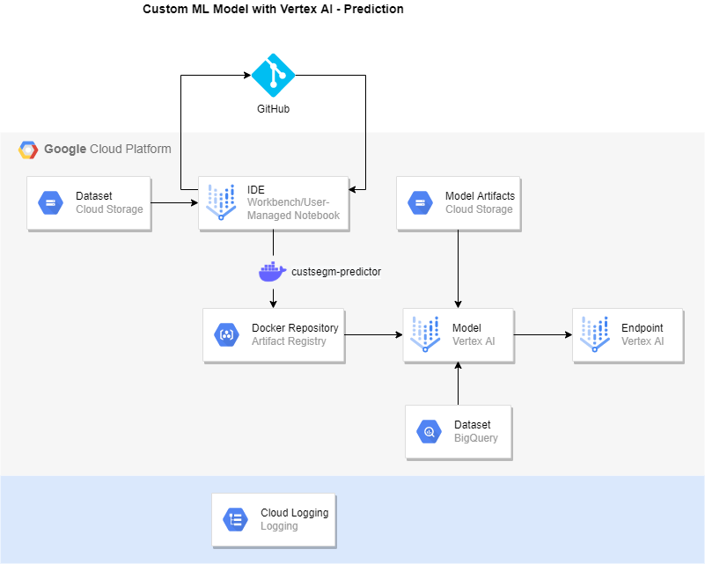
MLOps
Architecture
Vertex AI 2/2 - Prediction In:
Model
Prediction request
Out:
Prediction response

Slide 11
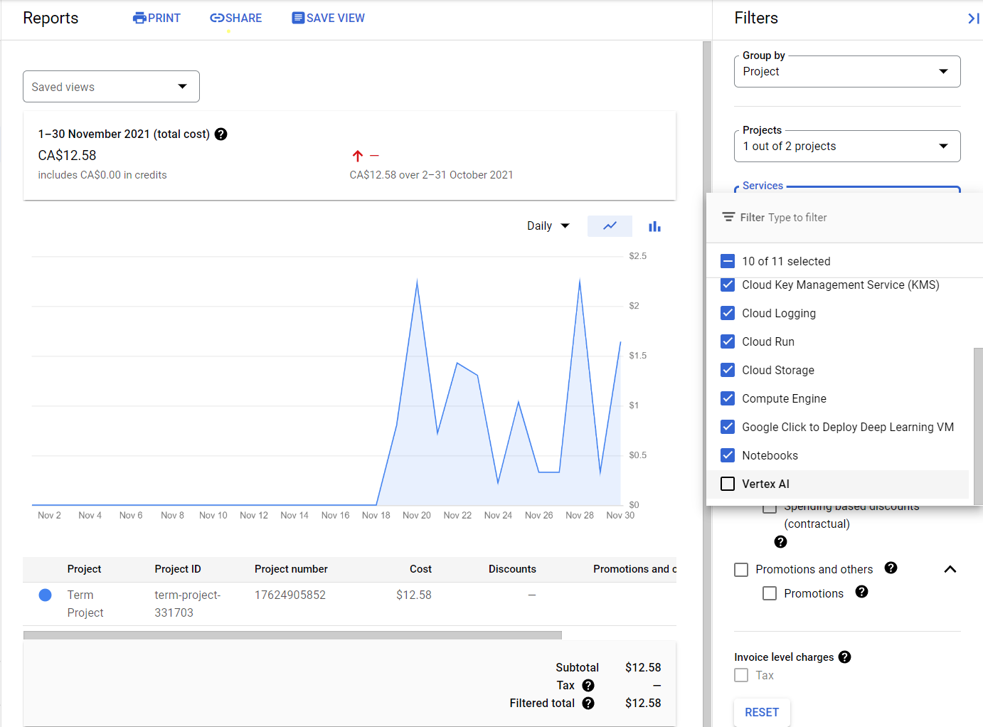
Costs
without
Vertex AI

Slide 12
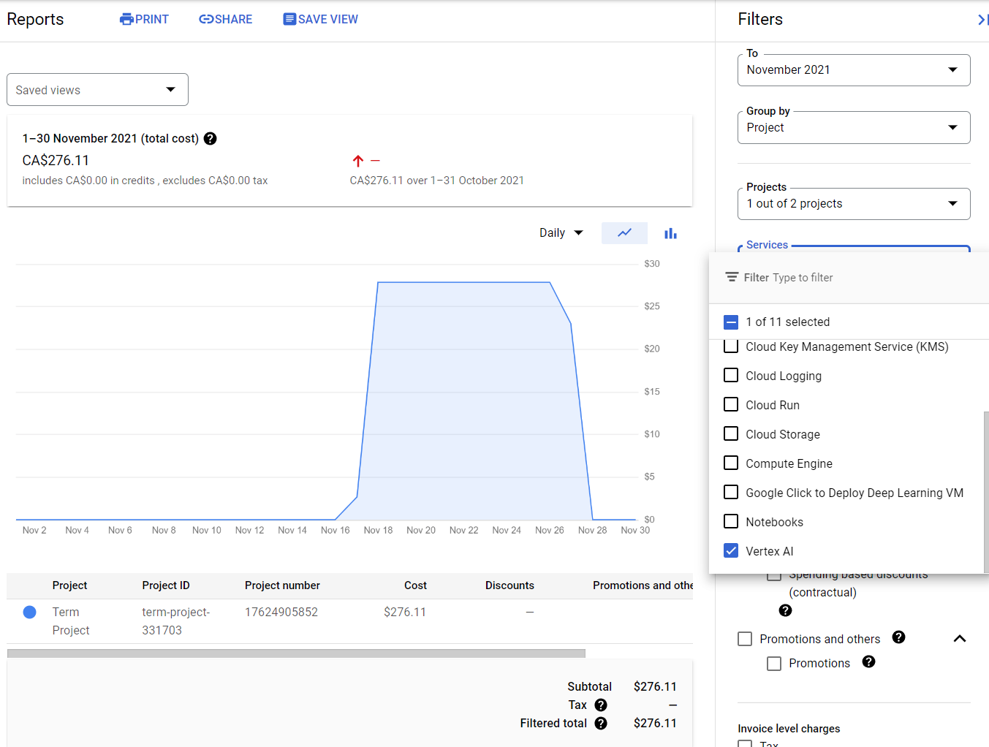
Costs of
Vertex AI
alone

Slide 13
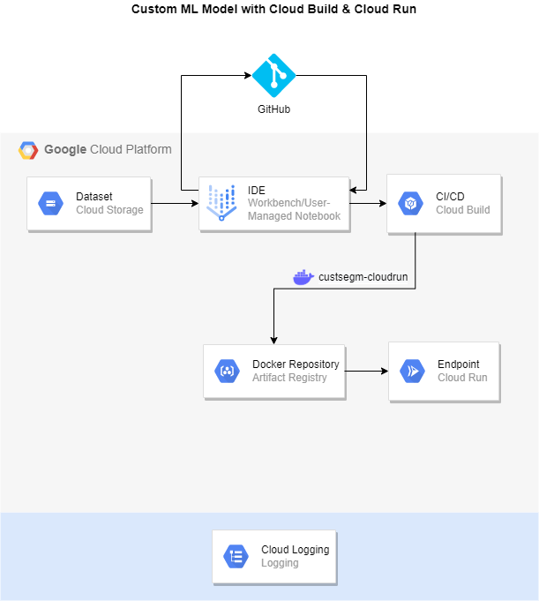
Straightforward Architecture
Cloud Run In:
Model
Prediction request
Out:
Prediction response

Slide 14
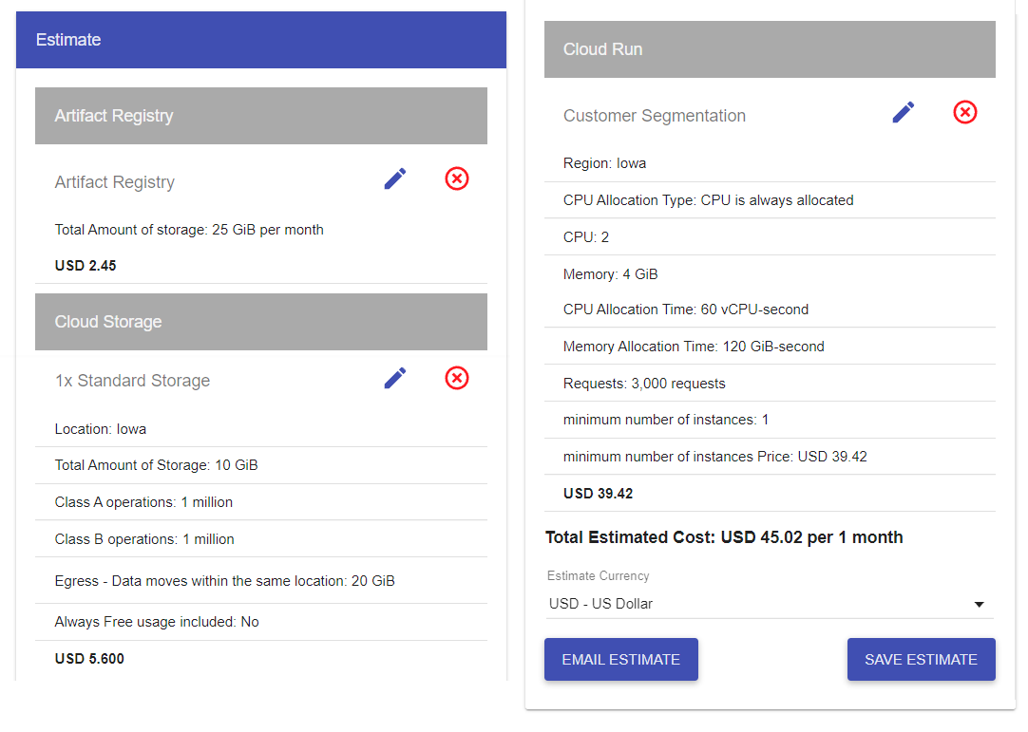
GCP Cost Estimate
USD 540.24 per 1 year

Slide 15
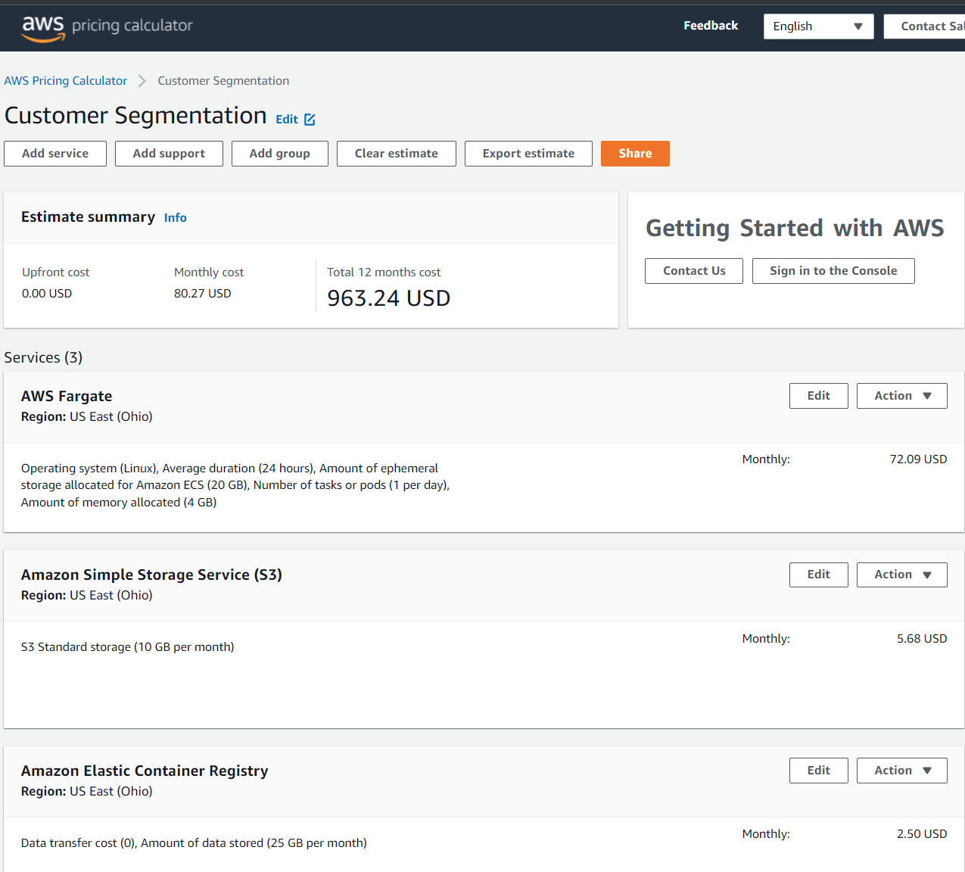
AWS Cost Estimate
78% more expensive
But it’s not an apples to apples comparison

Slide 16
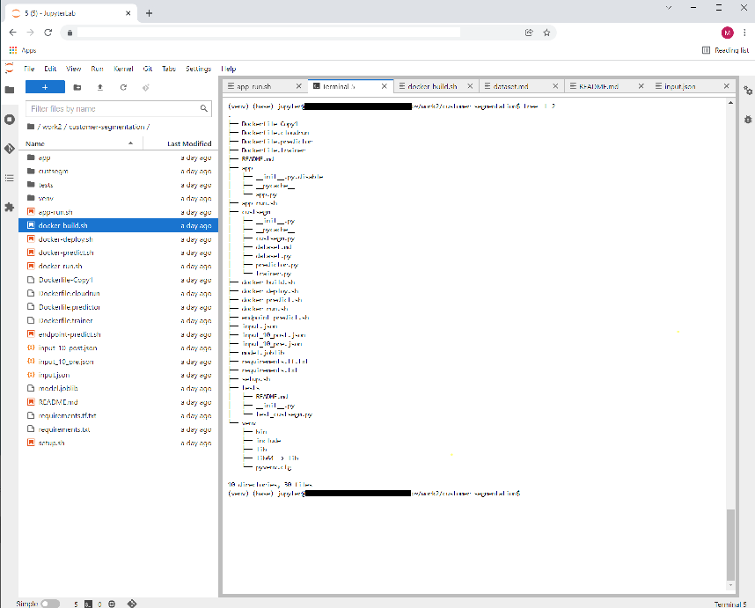
Solution Demo
https://youtu.be/piIXd4gfZE4

Slide 17

Conclusions
Vertex AI (and MLOps tooling in general) is still a work in progress
Depending on your process matury, it might not be cost-effective to use specific Vertex AI services
On GCP, Custom Containers need better documentation and up-to-date examples

